Slide 1

CSE 3002 - INTERNET AND WEB PROGRAMMING
QUIZZIE – THE QUIZ
MANAGEMENT SYSTEM

Slide 2
Group Members
REG. NO. 18BCE0283
19BCB0054
19BCE0148
19BCE0312
19BCE0541
NAME ANMOL PANT
TANYA GUPTA JUGAL BHATT ADITYA BERI
PRIYA GOVINDASAMY

Slide 3


Abstract
This project is a complete online quiz management platform with a plethora of features for
teachers and students.It provides all the basic functionalities of a quiz portal like timer, scoring,
ranking etc. alongside analysis of results from the students on the teacher dashboard, summary
of tests for the student, Login and signup using a Google account for both teacher and student.
It provides a smooth user interface for both the teachers and students to create and attempt
different kinds of quizzes seamlessly.

Slide 4


Motivation
The motivation of this project came from the idea to help teachers and institute
administrators create quizzes and tests in an efficient manner. With the popularity of the
Internet, it is inevitable to have online quizzes as classroom assessments. In learning,online quizzes may serve two objectives, that is, for self study or as a formal
assessment. The online quiz has its advantages, such as saving the cost of paper
printing and reducing the time spent for having assessments in class.
However, there
are weaknesses. Its primary drawback is the issue of academic dishonesty, especially
when students are answering the online quiz.

Slide 5
Aim of the proposed work
The purpose of this project is to create a web- based solution that
improves the overall efficiency and reduces the hassle of conducting
online quizzes. Also to provide necessary features for a teacher such as t imer, scoring, ranking etc. alongside analysis of results f rom the
students on the teacher dashboard, summary of tests. And to provide students with a seamless way of attempting quizzes, so that they can easily keep track of their progress.

Slide 6




OBJECTIVES
The objective is to help in the administration of online quizzes.With the popularity on the Internet, it is inevitable to have online quizzes as classroom assessments.
The teacher’s would have access to a dashboard with features like scoring, timing, and detailed statistics for each quiz.
The student’s would have access to a dashboard with all quizzes attempted, upcoming quizzes, and summary of all attempted tests.

Slide 7
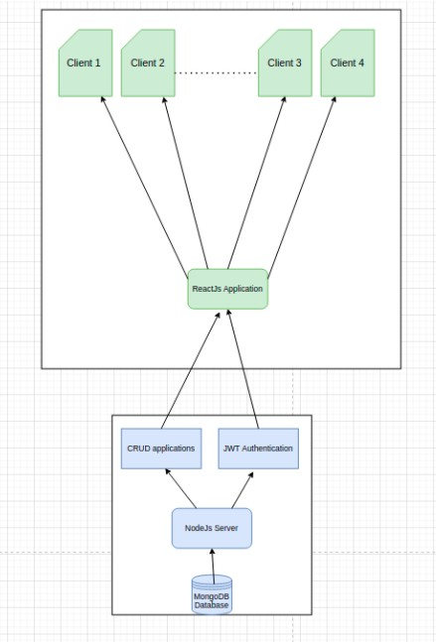
Architecture Diagram
The architecture diagram shows the interaction of the different components used to create the system. Users interact with the frontend which is a ReactJS application. The backend involves a CRUD (Create, Read, Update, Delete) application and JWT (JSON Web Token) Authentication that interact with the NodeJS server. All the data used in the application is stored in the MongoDB database.

Slide 8
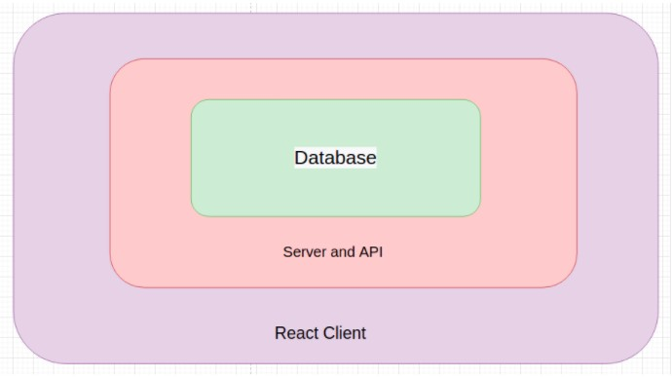
The application uses a three-tiered architecture. The React Client acts as the first tier or the presentation layer. The middle tier which contains all the server logic is implemented using a NodeJS server and other APIs. The Database containing all the data relevant to the application forms the third and final tier. It is implemented in MongoDB.

Slide 9
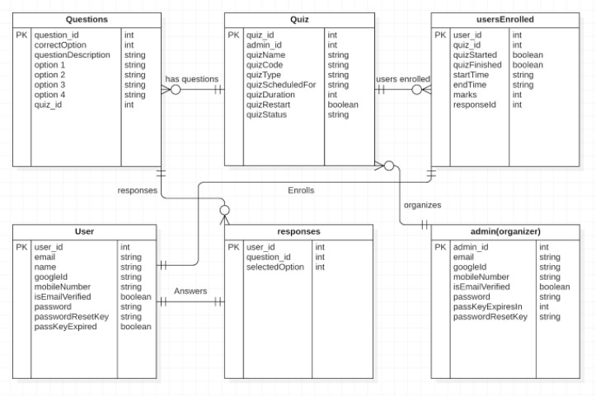
DB Design

Slide 10
The entity-relationship diagram above provides a clear description of the implementation of the database. Admins can organize one or many quizzes. Each quiz can have multiple questions and multiple enrolled users. The questions will have different responses depending on the user. The records for all the tables in the database are uniquely identified by their corresponding ID.

Slide 11
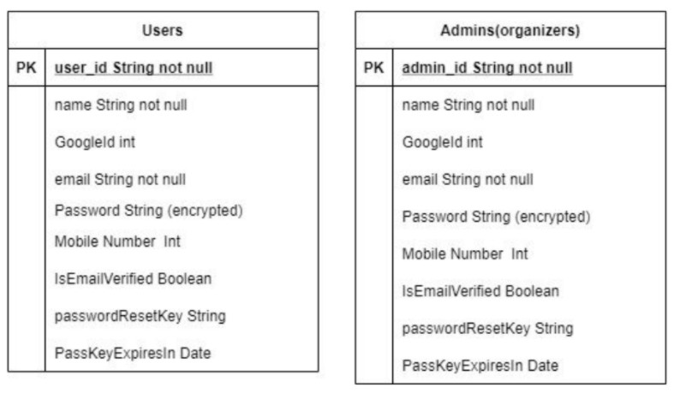
Schema

Slide 12
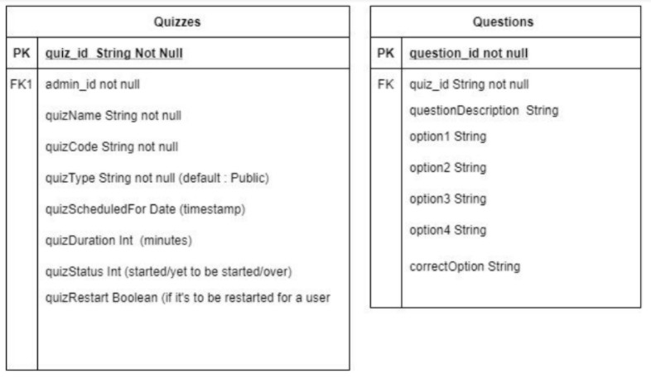

Slide 13
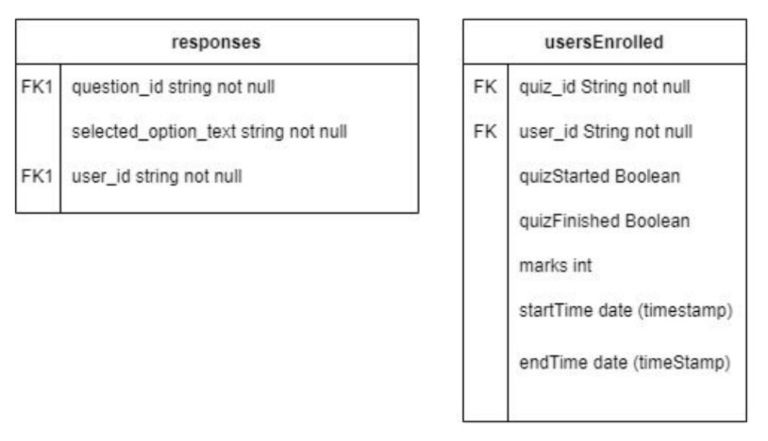
The database schema is a skeleton structure that represents the logical view of the entire database. It shows the associations between the tables through foreign keys. It also shows all the attributes possessed by each table.

Slide 14




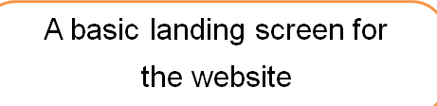

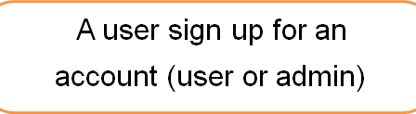

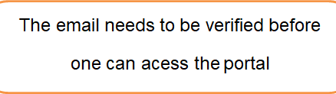

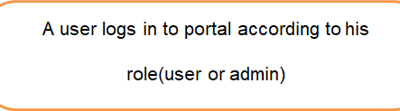
MODULE DETAILS

Slide 15




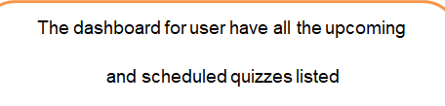
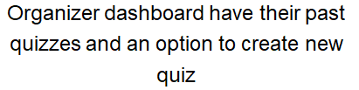
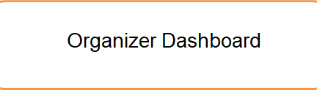

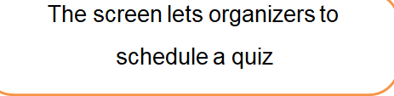

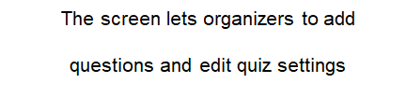

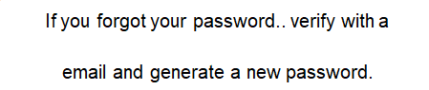

Slide 16


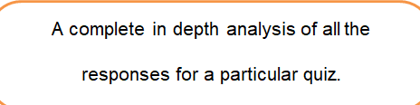


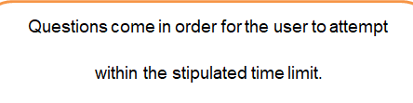

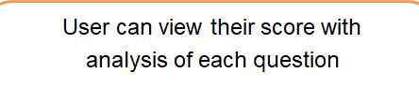



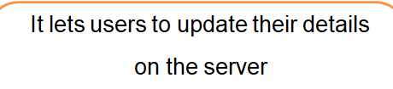

Slide 17
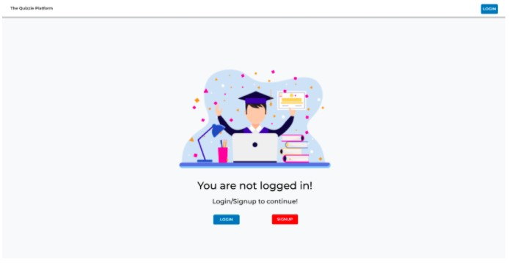
INTERFACES

Slide 18
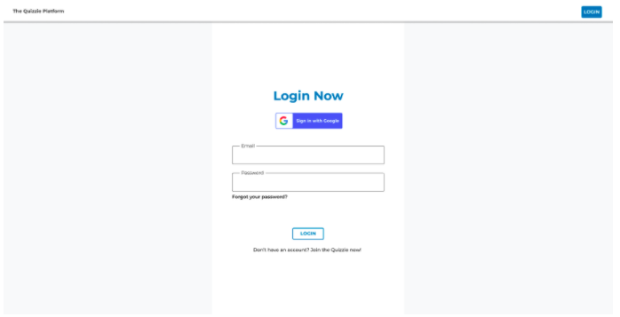

Slide 19
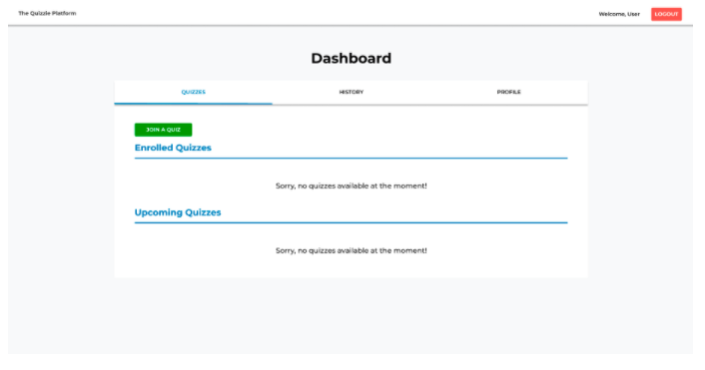

Slide 20
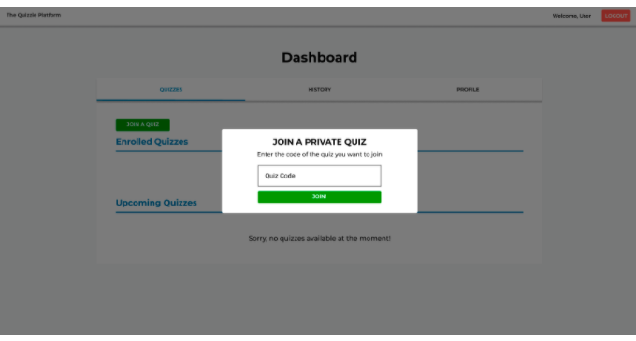

Slide 21
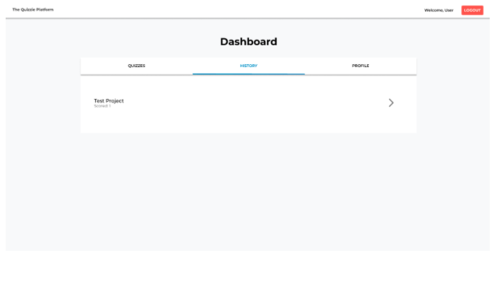

Slide 22
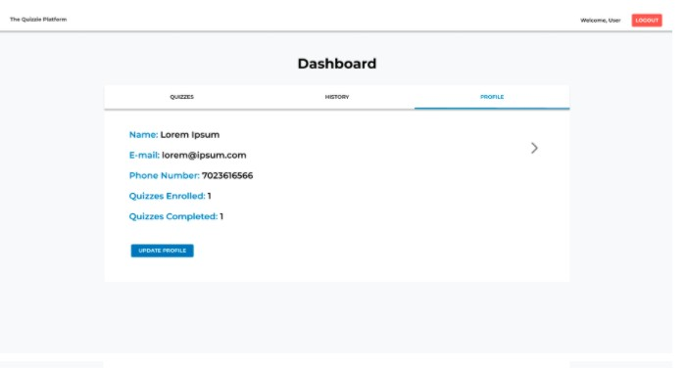

Slide 23
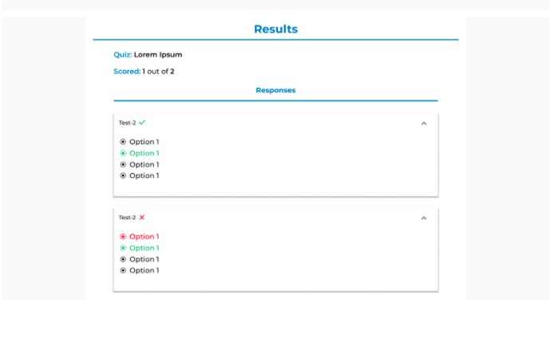

Slide 24

IMPORTANT LINKS
WEBSITE LINK
https://iwp.jugaldb.com
CODE BASE
https://github.com/jugaldb/quizzie-iwp

Slide 25
THANK YOU

